Slide 1
THEORY OF COMPUTATION
CSC-251
UNIT 2
DWIT
Sailesh.bajracharya@gmail.com
9841594548

Slide 2
Outline
Context –Free Grammar(CFG),Parse Trees, Derivation and Ambiguity, Normal Forms (CNF and GNF) of context -Free Grammar, Regular Grammars, Closure Properties of context- Free Languages, Proving a Language to be Non –Context – Free.
Push Down Automata (PDA), Languages of PDA, Deterministic and Non- deterministic PDA, Equivalences of PDA’s and CFG’s.

Slide 3

Grammars
Grammars express languages
Example: the English language grammar

Slide 4
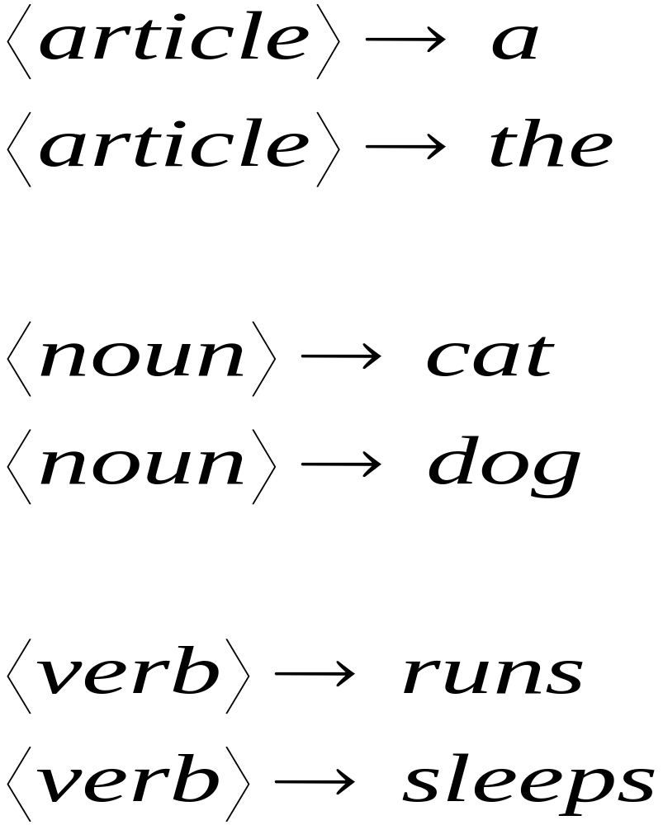
Grammar

Slide 5
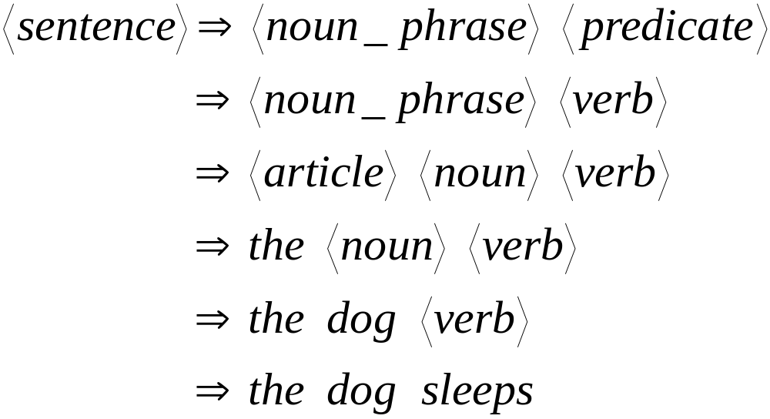
Derivation of string “the dog sleeps”:

Slide 6
Context Free Grammar(CFG)
more powerful method for describing languages
Consists of a ﬁnite set of grammar rules
Grammar rules :
  non-terminals (variables)
  terminals
A rule is of the form A → α, where A is a single nonterminal, and the right-hand side α is a string of terminal and/or nonterminal symbols
Unlike automata, grammars are used to generate strings, rather than recognize strings.

Slide 7
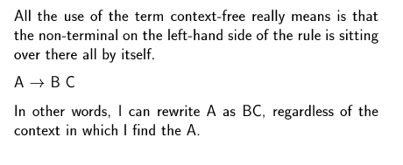
What `context free’ means

Slide 8
Context Free Grammar: Quadruple
G=(V ,T, P, S)
Set of variables
(non-terminals/syntactic categories)
Start Symbol
Set of Terminals
Set of Productions(rules)
Recursive definition of a language

Slide 9
Each Production rules consists of:
Head
  variable defined by the production
Production symbol →
Body
  string of zero or more terminals & variables
A Aab

Slide 10
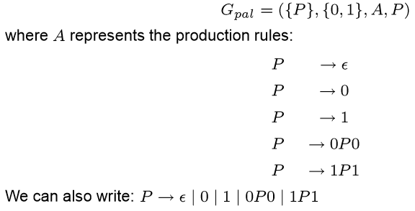
CFG for Palindromes

Slide 11
Examples: CFG for expressions in a typical
programming language
Operators: +(addition) and ∗(multiplication)
Identiﬁers: must begin with a or b, which may be followed by any string in {a,b,0,1}∗
We need two variables in this grammar:
  E: represents expressions .It is the start symbol.
  I: represents the identiﬁers.
    Its language is regular and is the language of the regular expression:
    (a+b)(a+b+0+1)∗

Slide 12
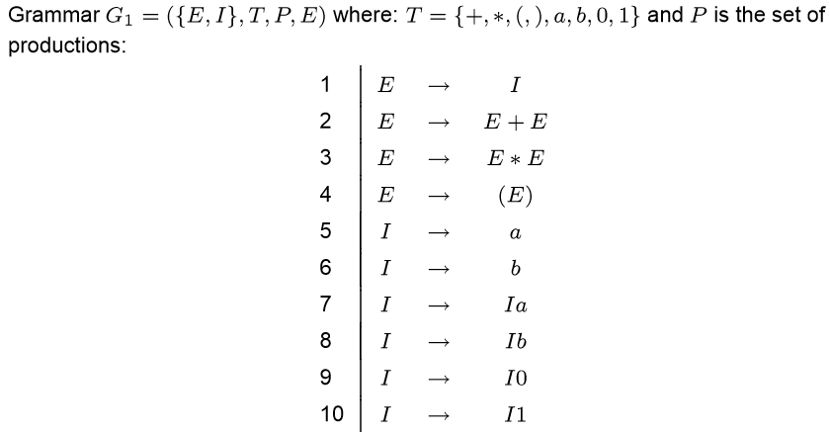
Example: The Grammar

Slide 13
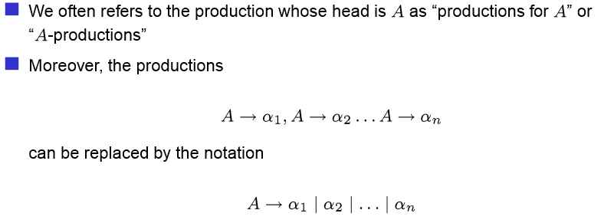
Compact Notation for Productions

Slide 14
Derivations Using a Grammar
We apply the productions of a CFG to infer that certain strings are in the language of a certain variable
Two inference approaches:
  Recursive inference(using productions from body to head)
  Derivations(using productions from head to body)

Slide 15
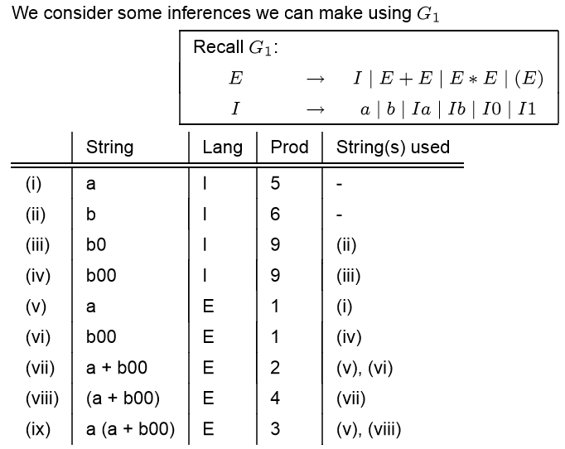
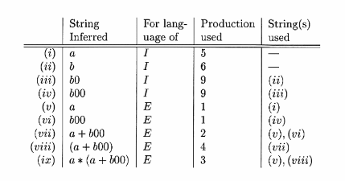
Recursive Inference - Example

Slide 16
Sample CFG
E→I // Expression is an identifier
E→E+E //Add two expressions
E→E*E //Multiply two expressions
E→(E) //Add parenthesis
I→ L // Identifier is a Letter
I→ ID //Identifier + Digit
I→ IL //Identifier + Letter
D → 0 | 1 | 2 | 3 | 4 | 5 | 6 | 7 | 8 | 9 // Digits
L → a | b | c | … A | B | … Z // Letters
Note Identifiers are regular; could describe as (letter)(letter + digit)*

Slide 17
Recursive Inference - Example
Process of coming up with strings that satisfy individual productions and then concatenating them together according to more general rules is called recursive inference.
Bottom-up approach
For example, parsing the identifier “r5”
  Rule 8 tells us that D → 5
  Rule 9 tells us that L → r
  Rule 5 tells us that I→L so I→r
  Apply recursive inference using rule 6 for I→ID and get
    I → rD.
    Use D→5 to get I→r5.
  Finally, we know from rule 1 that E→I, so r5 is also an expression.

Slide 18
Recursive Inference - Exercise
Show the recursive inference for arriving at (x+y1)*y is an expression
  E→I
  E→E+E
  E→E*E
  E→(E)
  I→ L
  I→ ID
  I→ IL
  D → 0 | 1 | 2 | 3 | 4 | 5 | 6 | 7 | 8 | 9
  L → a | b | c | … A | B | … Z

Slide 19
Derivations– top to down approach
Applying productions from head to body requires the deﬁnition of a new relational symbol: ⇒
Let:
  G=(V,T,P,S) be a CFG
  A∈V
  α,β⊂(V∪T)∗ and
  A→γ∈P
Then we write
αAβ⇒_{G} αγβ
or, if G is understood
αAβ⇒αγβ
And say that αAβ derives αγβ.

Slide 20
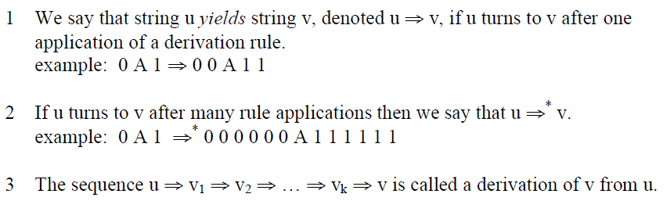
Derivation: Definition

Slide 21
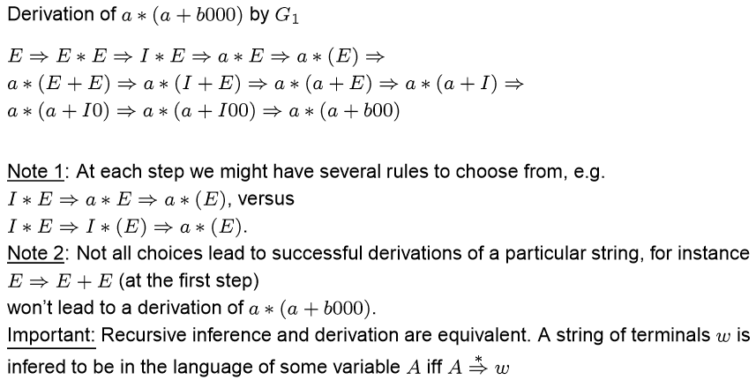
Examples of derivation

Slide 22
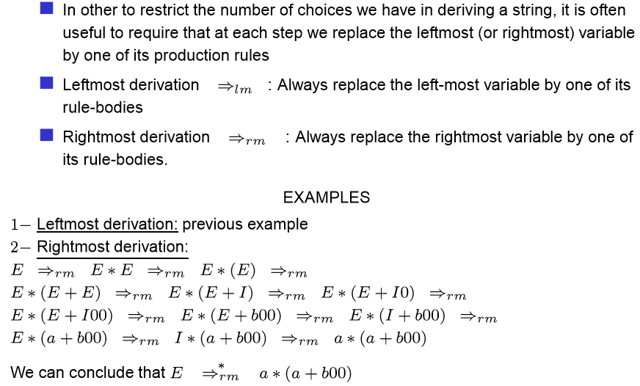
Leftmost and Rightmost derivation

Slide 23
Left or Right?
Does it matter which method you use?
Answer: No
Any derivation has an equivalent leftmost and rightmost derivation. That is, A ⇒* α. iff A ⇒*_{lm} α and A ⇒*_{rm} α.

Slide 24
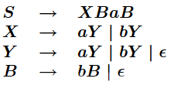
Leftmost and rightmost Derivation example
Generate: aaabba

Slide 25
Leftmost and rightmost Derivation example
Generate: aaabba

Slide 26
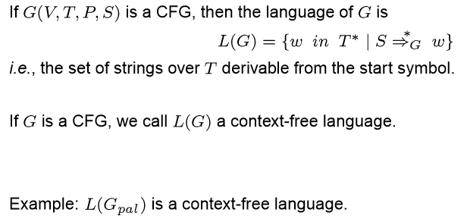
The Language of the Grammar

Slide 27
Give a CFG for the CFL 0^{n}1^{n} , where n>=1
  A → 0A1
  A → B
  B → ε
Start: A; Σ = {0, 1}
Here is an example of using it to produce (or derive) a string:
  A → 0A1
  → 00A11
  → 000A111
  ….. …. …..
  → 0^{n}A1^{n}
  → 0^{n}B1^{n}
→ 0^{n}1^{n}

Slide 28
CFG example
Consider the grammar that generates “ababcbcbb”
S → abScB | λ
B → bB | b
2. {w | w starts and ends with the same symbol}

Slide 29
CFG example
{w | w starts and ends with the same symbol}
  S → 0A0 | 1A1
  A → 0A | 1A | λ

Slide 30
Parse Trees( Derivation Trees)
Top-Down Tree Representation for derivation
  Good way to visualize the derivation process
How the symbols of a terminal string are grouped into substrings
A picture of the structure that a grammar places on the strings of its language

Slide 31
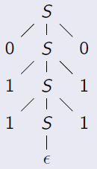
Parse Trees
For CFG G = (V;; R; S), a parse tree (or derivation tree) of G is a tree satisfying the following conditions:
  Each interior node is labeled by a variable in V
  Each leaf is labeled by either a variable, a terminal or ε ;
  a leaf labeled by ε must be the only child of its parent.
  If an interior node labeled by A with children labeled by X1,X2,….Xk (from the left), then A→X1X2…Xk must be a rule.
011110
Yield of a parse tree is the concatenation of leaf labels (left-right)

Slide 32
Parse Trees a*(b+c)
E
E
E
*
I
E
+
E
I
I
a
b
c

Slide 33
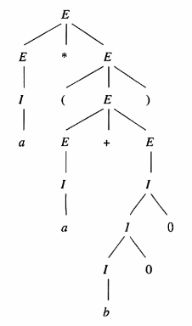
Parse Tree for: a*(a+b00)

Slide 34
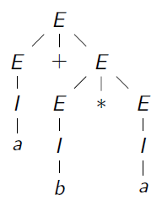
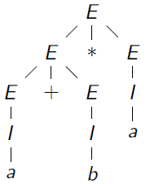
Multiple Parse Trees

Slide 35
Ambiguity: Grammar

Slide 36
Removing Ambiguity
Ambiguity maybe removed either by
  Using the semantics to change the rules.
    For example, if we knew who had the bat (the girl or the boy) from the context, we would know which is the right interpretation.
  Adding precedence to operators.
    For example, * binds more tightly than +, or “else" binds with the innermost “if".

Slide 37
Inherently Ambiguous Languages

Slide 38
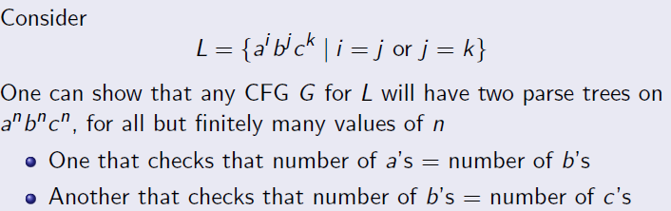
Inherently Ambiguous Languages: Example

